Slide 1
UVic Course Registration System
B03 - Group 6
Zhanchi Guan, Aaron Yin,
Rui Sun, Junhong Deng

Slide 2
Project overview
Motivation:
Outdated interface
No visible timetable when registering
Goal:
Clearer interface
Better visuals
More interactive

Slide 3
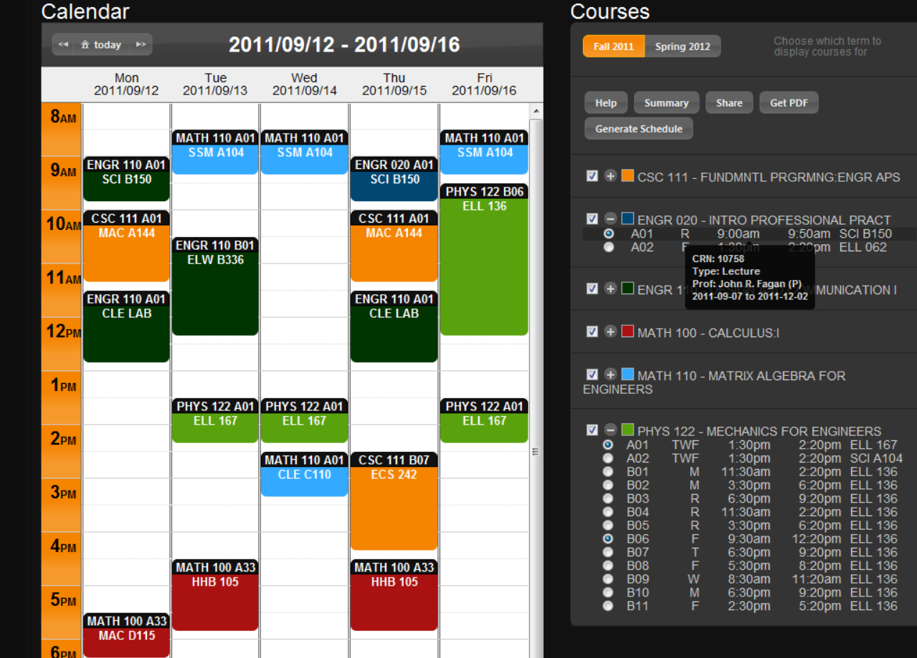
Brief related work
schedulecourses.com

Slide 4
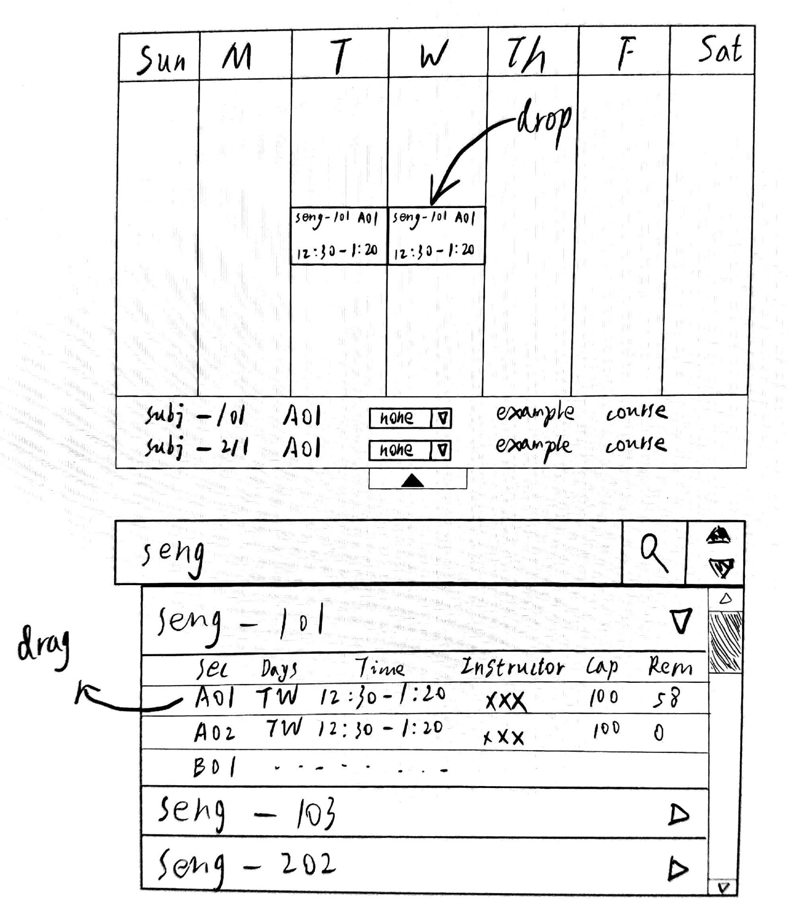
Proposal sketch
Visible timetable
Search bar
drag-and-drop

Slide 5
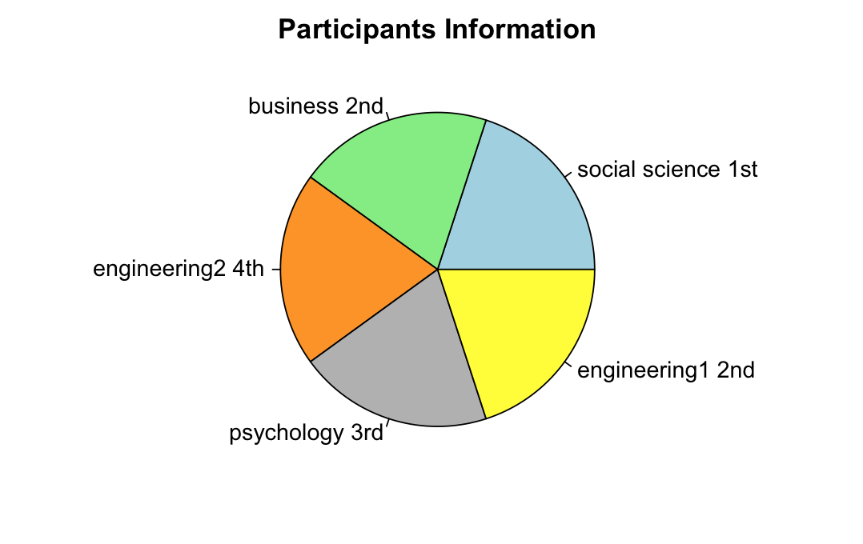
Participants
-5 UVic students
-different year standing
-mostly different faculties

Slide 6
Key user research findings
Satisfied:
Categorization of subjects
Unsatisfied:
Lack of visible timetable
Opening multiple tabs
Memorizing CRN’s
"Timetable builder" not savable

Slide 7
Design requirements
Update/merge tools
Easy-to-understand user interface
Easy access to helpful information
New user friendly

Slide 8
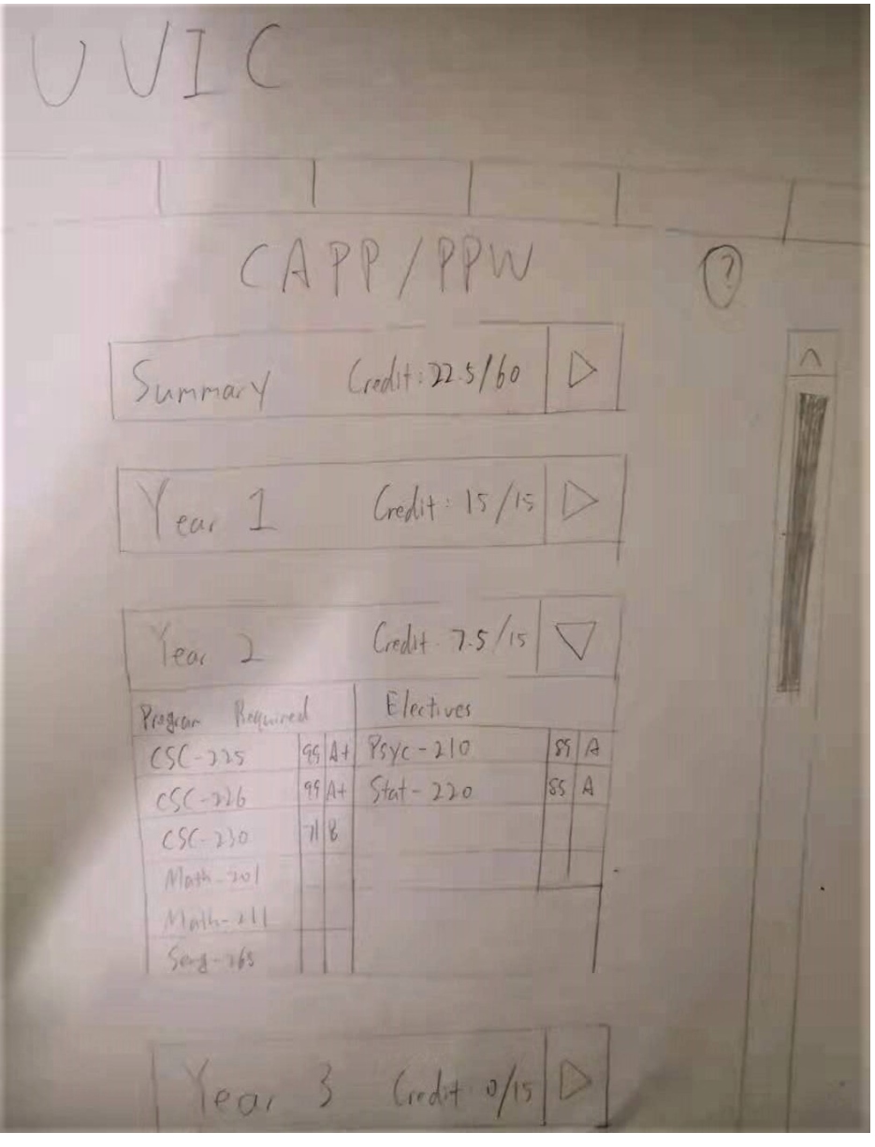
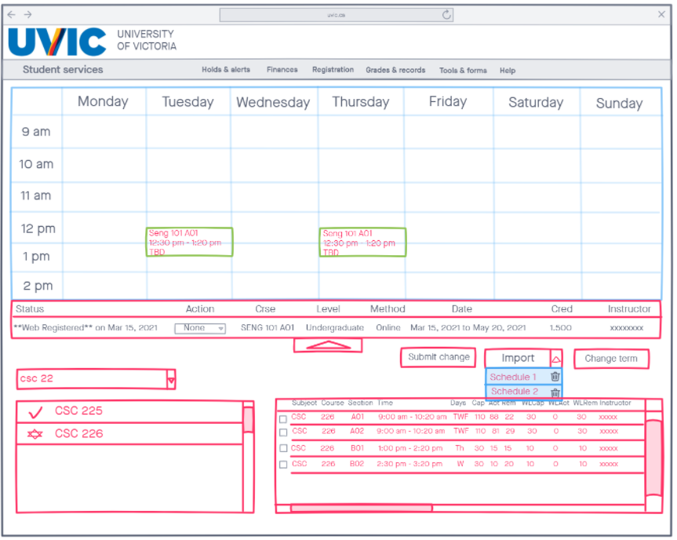
Brainstorm
Sketches

Slide 9
Prototype evolution: Medium fidelity
Balsamiq for creating pages and objects
Invision for implementing interactions

Slide 10
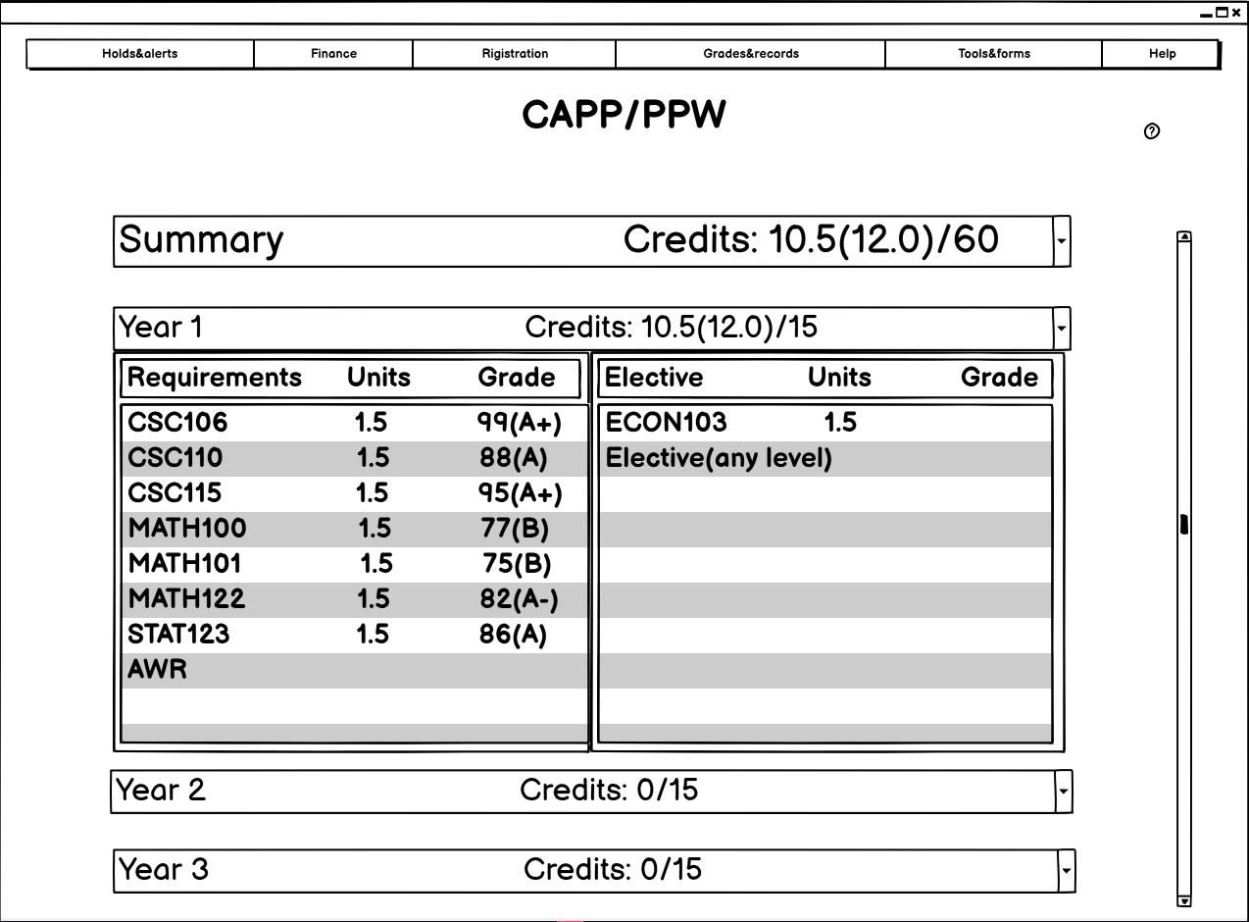
CAPP
year 1 - year 4
required, elective

Slide 11
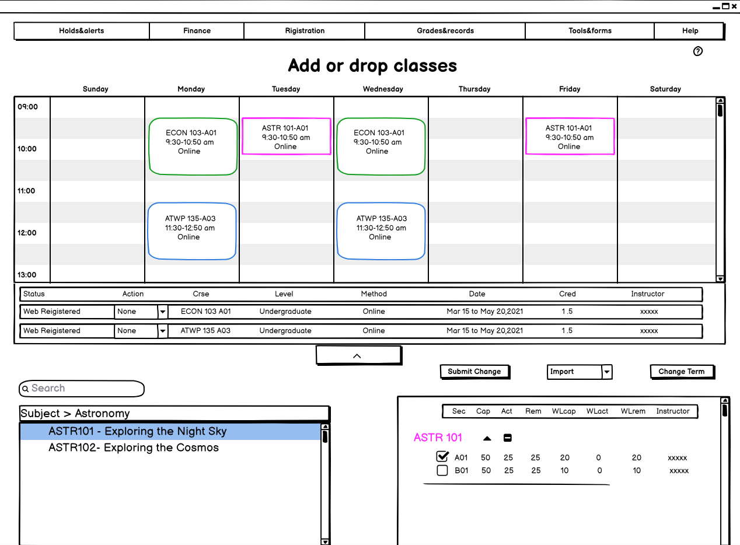
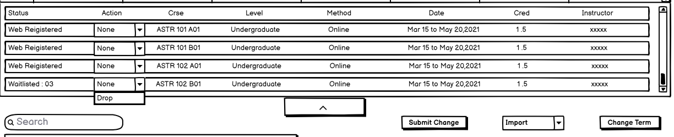
Add or drop classes
Search courses
Add courses
Drop courses

Slide 12
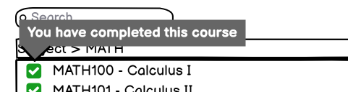
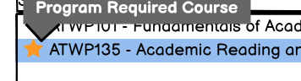
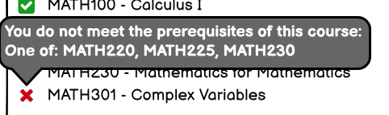
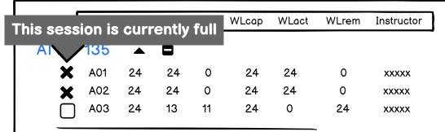
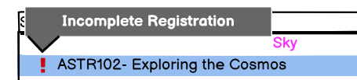
Special indications

Slide 13
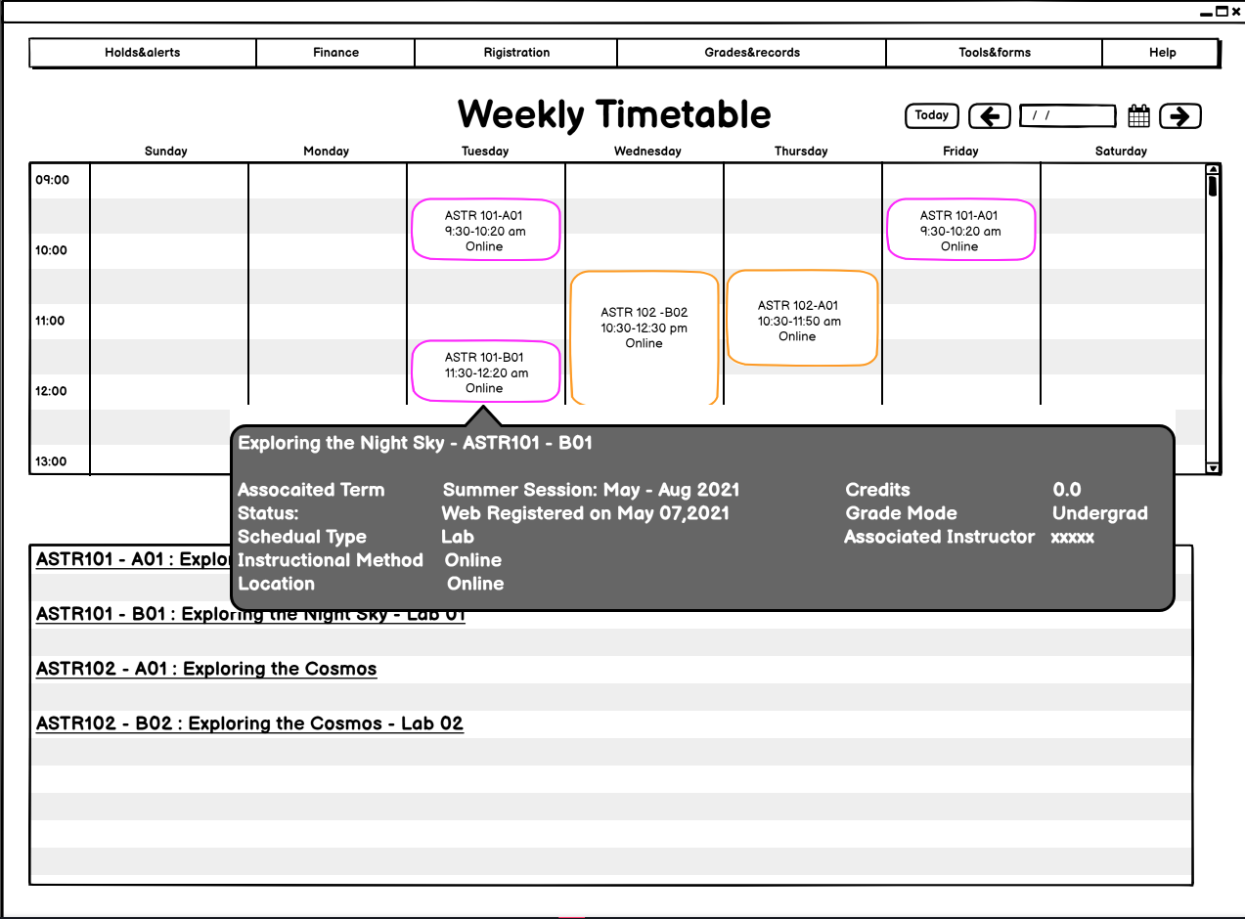
Weekly timetable
Review courses

Slide 14
Final Evaluation With Users
Zoom
Remote usability test
Interview

Slide 15
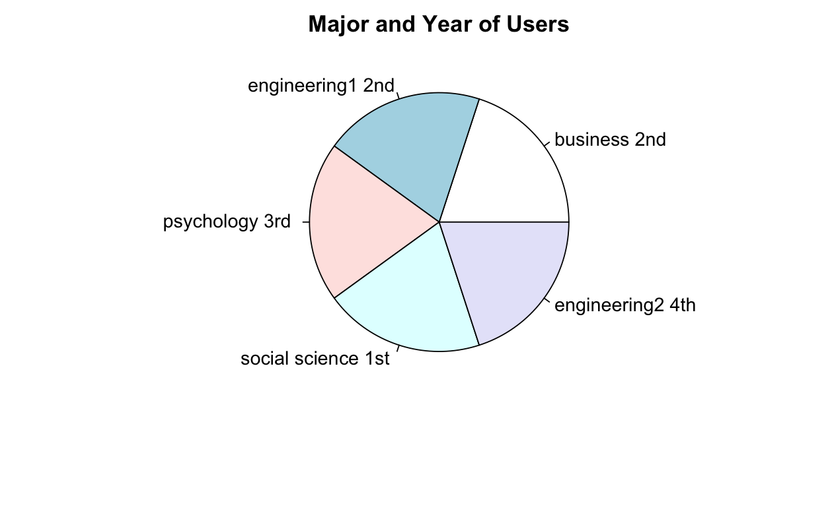
Participants Distribution
5 UVic students
3 from previous research

Slide 16
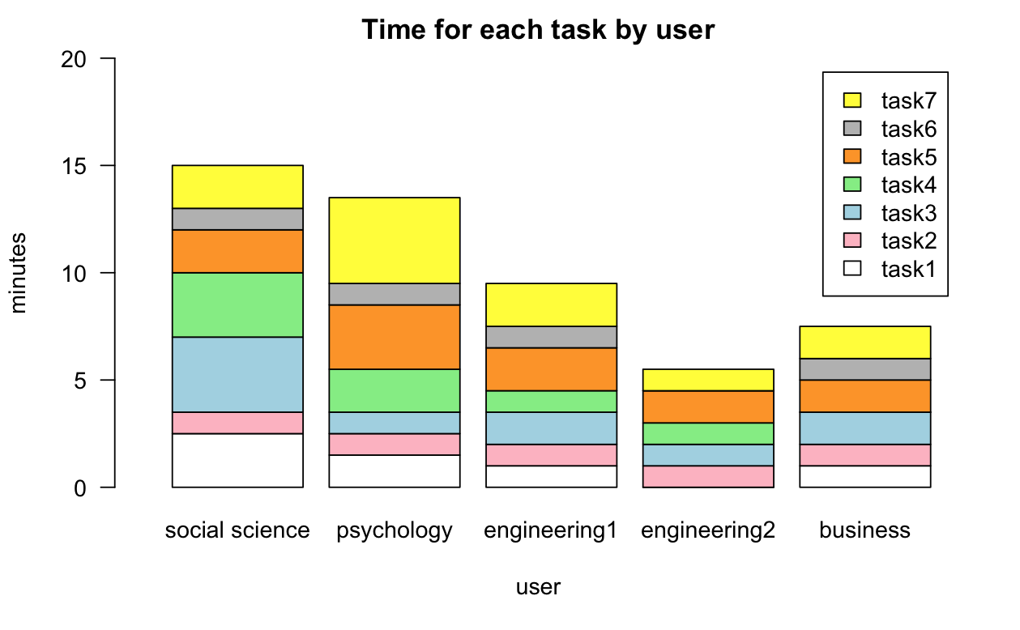
Task completion
Total average time: 10.2 min
Total average mistakes: 3.6
Total average hints: 6

Slide 17
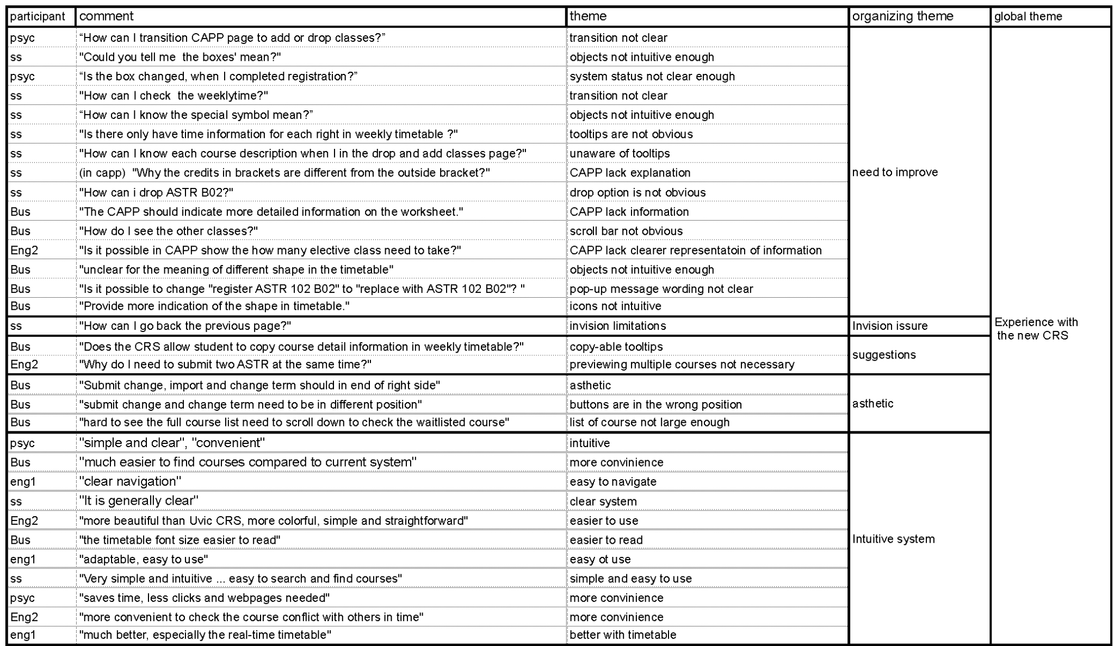
Feedbacks
Unanimously positive: simple and convenient
Average score: 8.92/10
Special indications not intuitive enough
CAPP not clear enough

Slide 18
Future work
Implementing more help functions
More clear indications
(i.e warning & confirmation messages )
Completing the prototype
Increasing data size

Slide 19
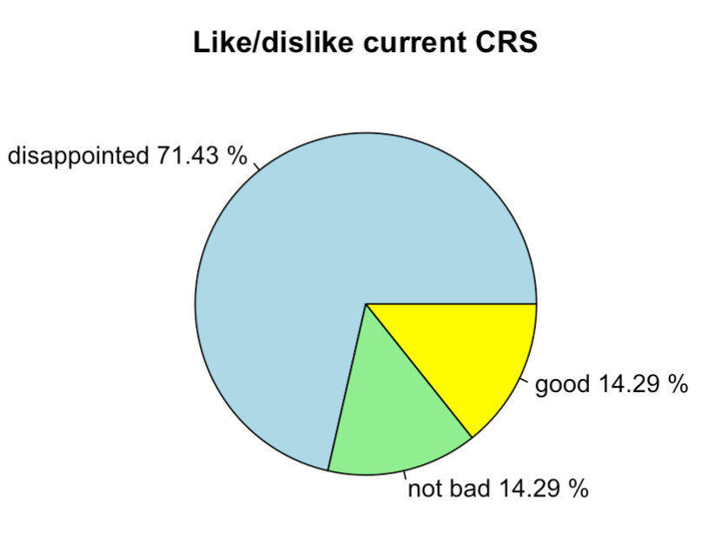
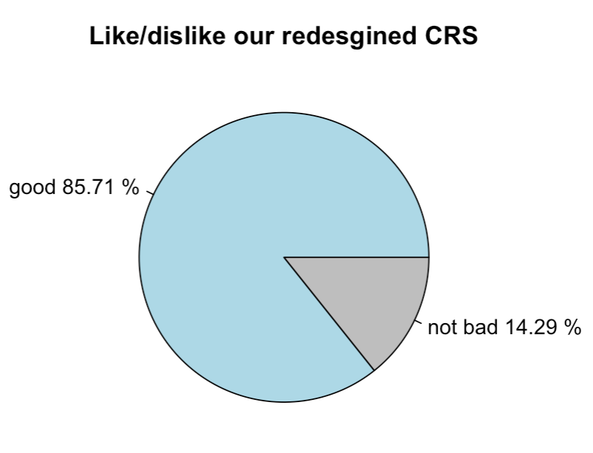
Conclusion
Combined search,add,drop courses
Clearly CAPP page
Friendly to new users

Slide 20
Q&A

Slide 21
Thank you

